Slide 1
SAP BTP Architect Training
Day 7
Anubhav Oberoy
www.AnubhavTrainings.com
Follow excellence with sheer passion

Slide 2


DISCLAIMER
The training content and delivery of this presentation is confidential, and cannot be recorded, or copied and distributed to any third party, without the written consent of Anubhav Trainings

Slide 3
Agenda – Day 7
01
04
Use SDI with Real time Replication & Virtual Tables
Recap Extensions
02
05
HANA Native Development
Create HDI and Native HANA development
03
06
Approach for Native Development
Adding Calculation views and HANA Objects

Slide 4
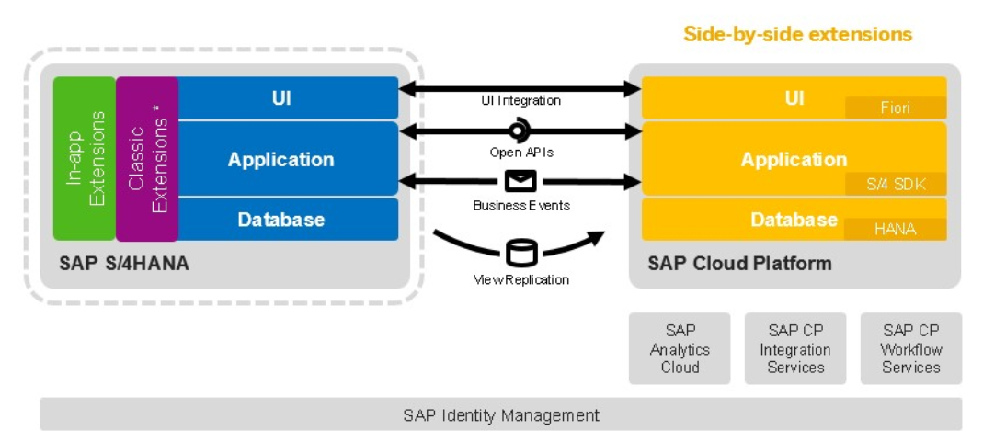
Approaches for Side-by-Side Extension

Slide 13

What We Did
Let’s Summarize

Slide 14

www.anubhavtrainings.com
Thank You
End of Day 7

Slide 15


We’re committed to empower you to be
#FutureReady
through powerful training solutions.
We build the workforce of the future.
270+
Corporate Clients
70,000+
Learners Trained
27000+
Learners Placed
FREE WEBINARS
Sign up for free webinars with industry experts every fortnight!
Enroll Now!
Contact us today!
https://anubhavtrainings.com

